Slide 1
Creating real world User Interfaces with Xamarin.Forms

Slide 2

Who’s this guy?
Harikrishnan
Product Lead – Syncfusion Inc.
harikrishnann@syncfusion.com
https://www.syncfusion.com/products/xamarin

Slide 3

Agenda
Quick overview of Xamarin
Crafting real world applications with Xamarin
Creating real world UI with Syncfusion components
A demo application

Slide 4


Slide 5

Write Once, Run Anywhere

Slide 6
Architecting Mobile Apps

Slide 7
Xamarin’s Unique Approach
iOS C# UI
Android C# UI
Windows C# UI
Shared C# Mobile
Shared C# codebase • 100% native API access • High performance

Slide 8
Xamarin is included in Visual Studio
Xamarin is included
in Visual Studio
Including Community Edition!

Slide 9
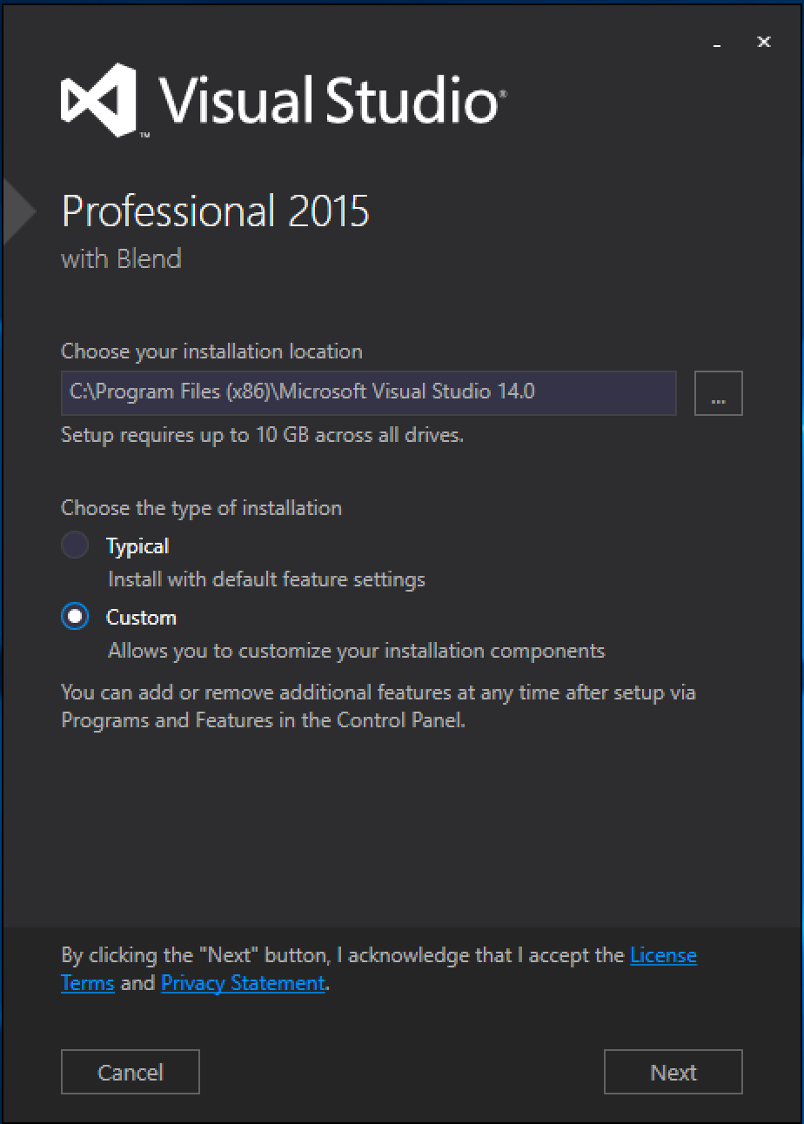
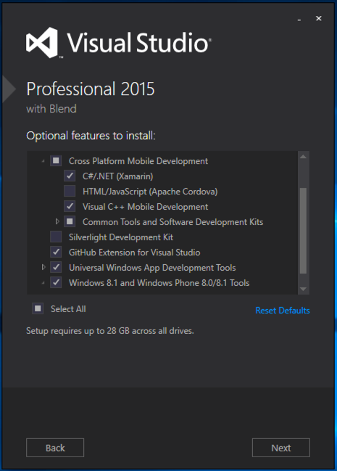
Visual Studio Integration
Xamarin.com/Download

Slide 10
Xamarin is Open Source!
open.xamarin.com

Slide 11
What’s included
✓ 40+ Pages, layouts, and controls
(Build from code behind or XAML)
✓ Two-way data binding
✓ Navigation
✓ Animation API
✓ Dependency Service
✓ Messaging Center
Shared UI Code
Shared C# Backend

Slide 12

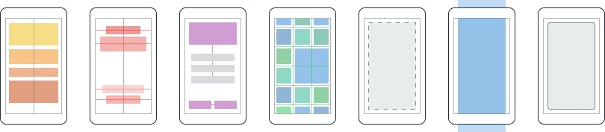
Layouts
Pages
Content
MasterDetail
Navigation
Tabbed
Carousel
Stack
Absolute
Relative
Grid
ContentView
ScrollView
Frame

Slide 13
Controls
ActivityIndicator
BoxView
Button
DatePicker
Editor
Entry
Image
Label
ListView
Map
OpenGLView
Picker
ProgressBar
SearchBar
Slider
Stepper
TableView
TimePicker
WebView
EntryCell
ImageCell
SwitchCell
TextCell
ViewCell

Slide 14
UITextField
Entry
EditText
TextBox

Slide 15
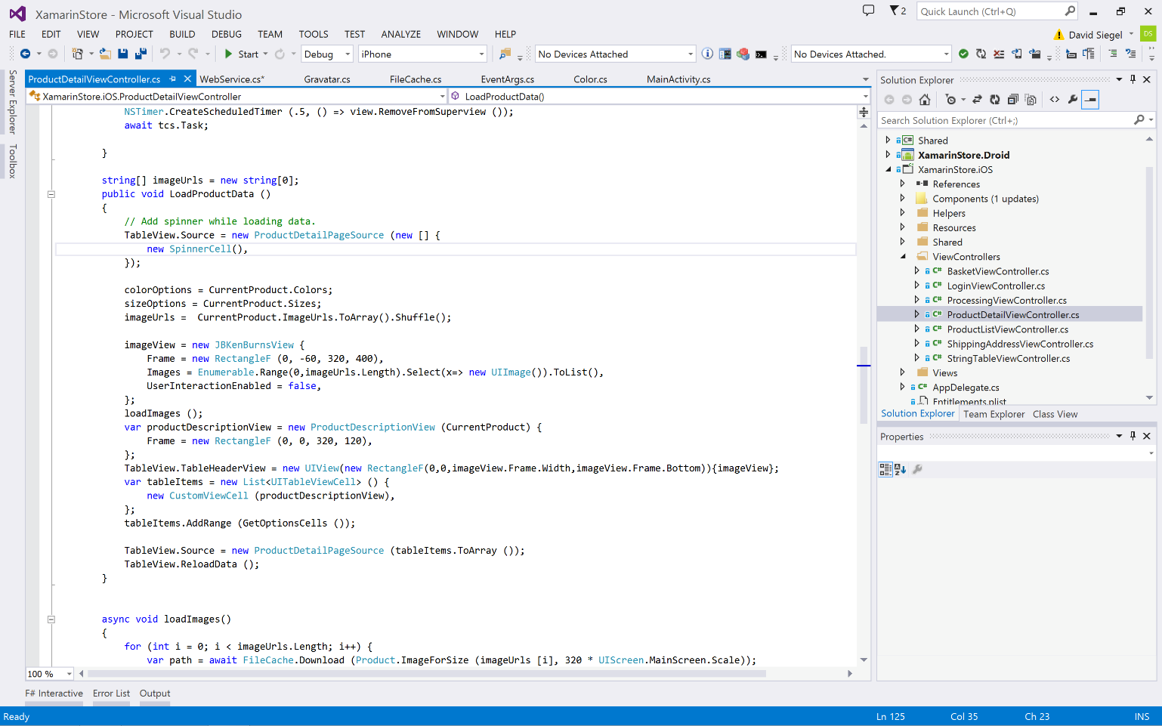
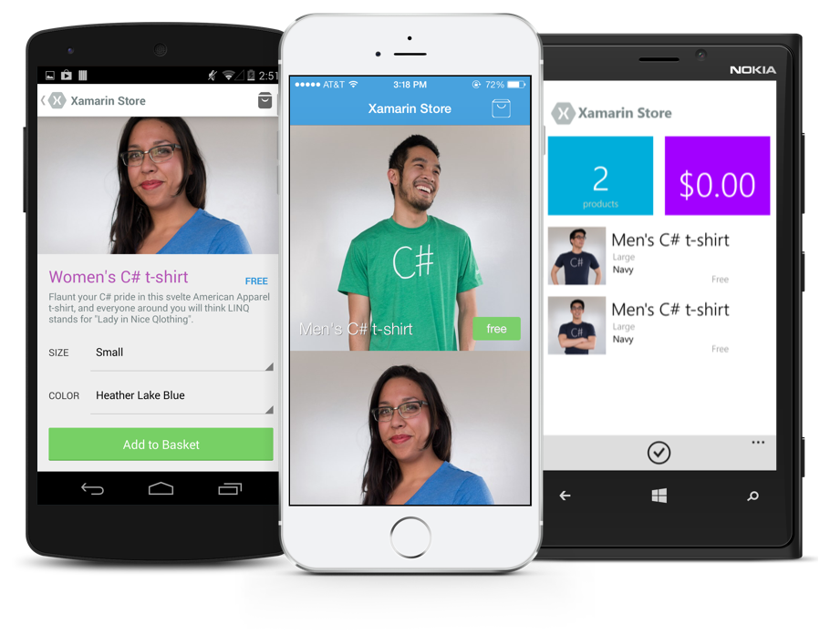
Anything you can do in Objective-C, Swift, or Java can be done in C# and Visual Studio with Xamarin.

Slide 16
Sharing Code

Slide 17
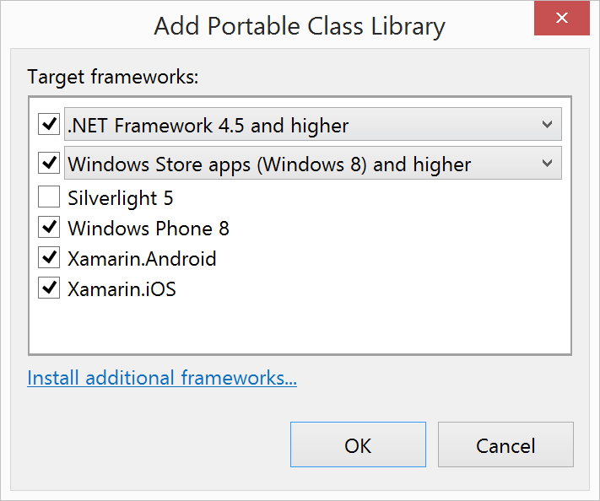
Portable Class Libraries
1 Assembly
Multiple Platforms
Including:
Xamarin.iOS and Xamarin.Android

Slide 18
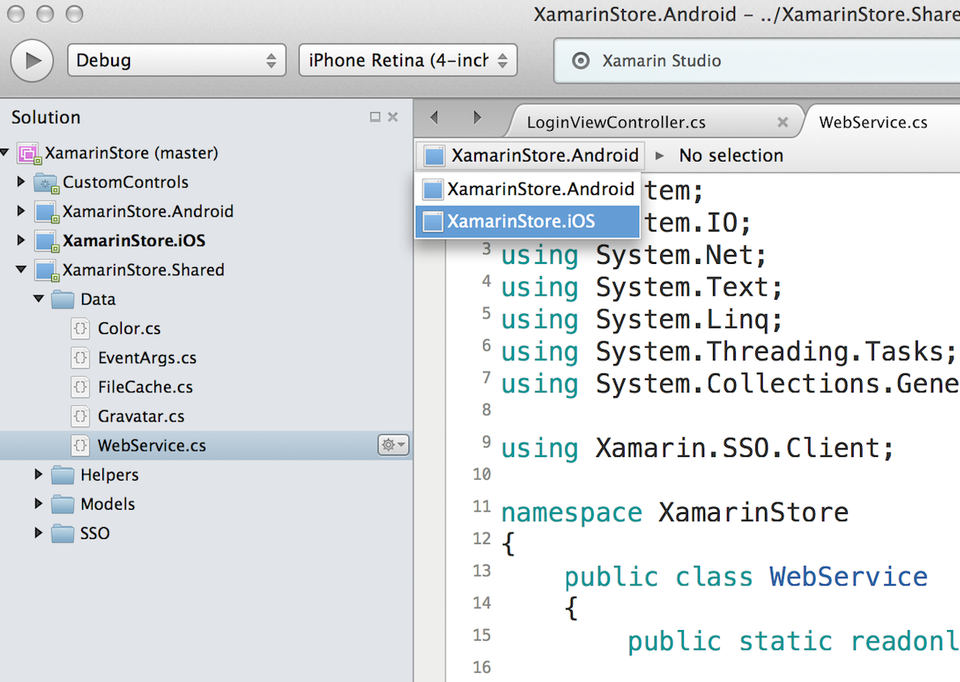
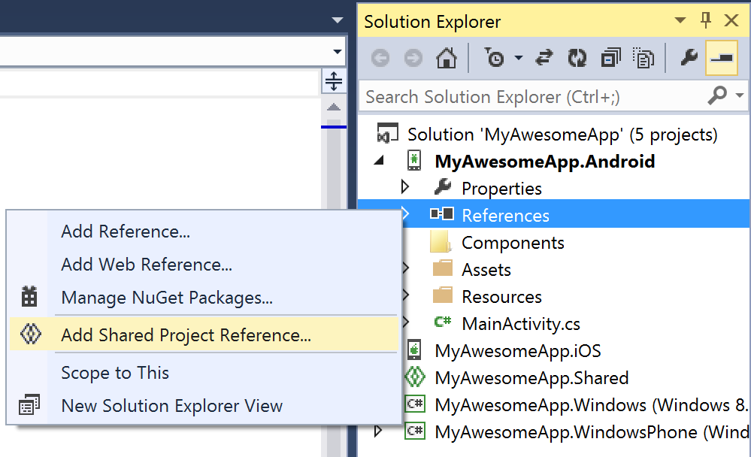
Shared Projects

Slide 19
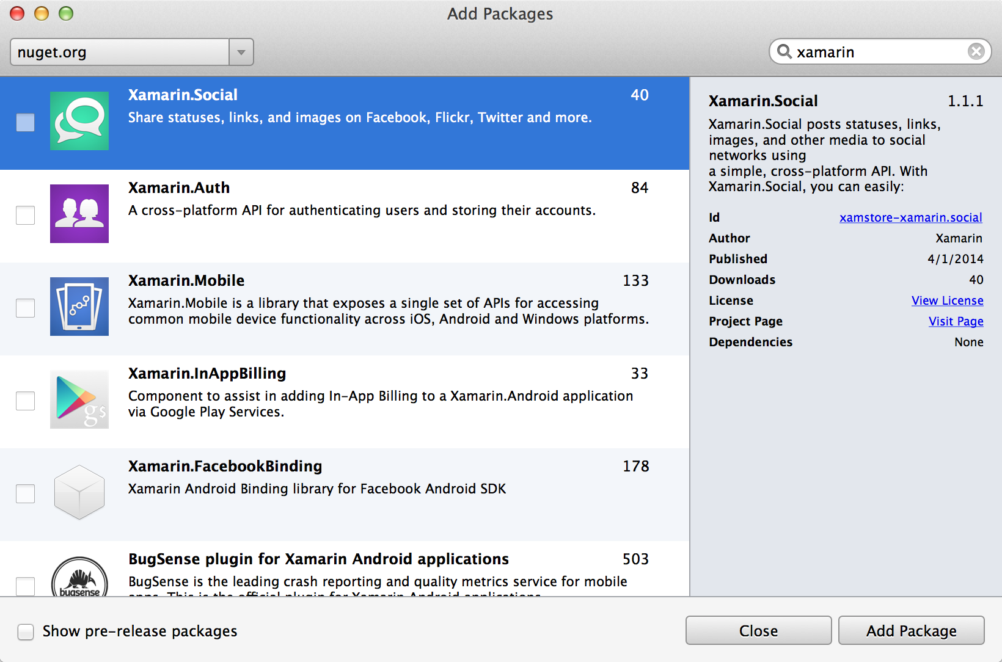
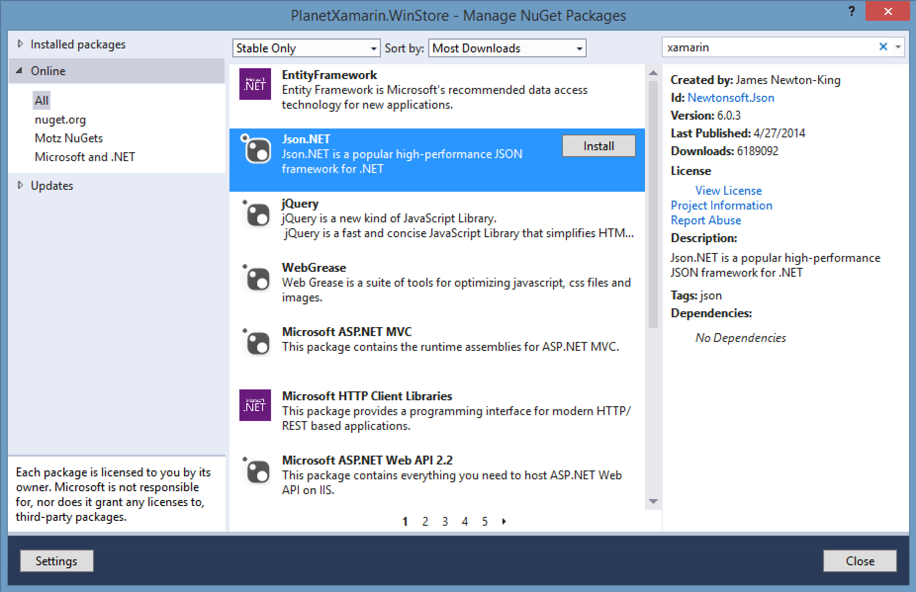
NuGet

Slide 20
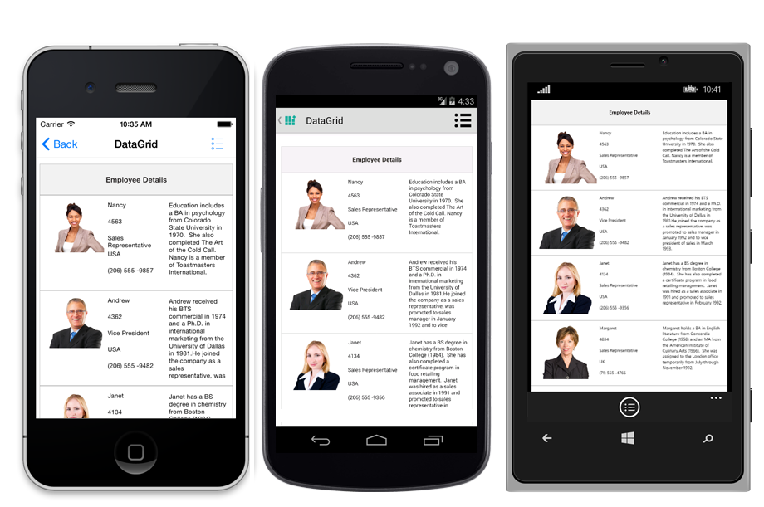
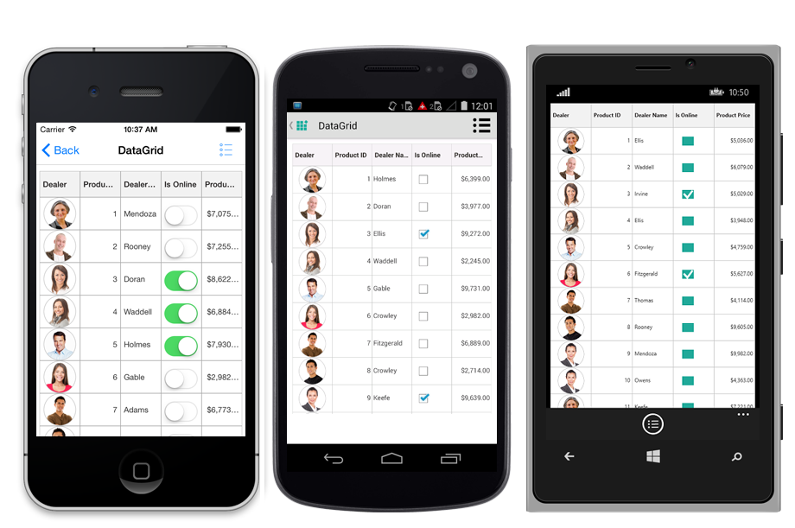
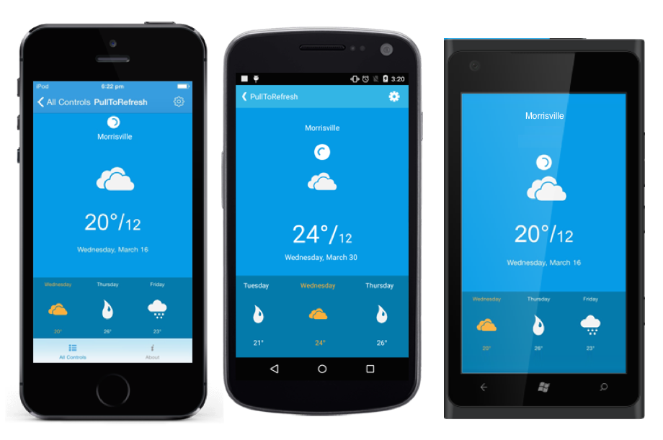
Creating real world UI with Syncfusion components
Stunning data visualization and data bound components
Unique Excel, Word, and PDF manipulations
Full Xamarin.Forms Support
iOS, Android, and Windows
C# or XAML
Data Binding Support

Slide 21
Let’s Build an App

Slide 22
Demo - https://github.com/syncfusion/Xamarin-ExpenseAnalysis
Demo and Slide document -
https://github.com/harikrishnann/c-sharp_corner_conference
SQLite for Universal Windows Platform
https://marketplace.visualstudio.com/items?itemName=SQLiteDevelopmentTeam.SQLiteforUniversalWindowsPlatform

Slide 23
Thank you ☺
Harikrishnan
Syncfusion Inc.
harikrishnann@syncfusion.com nharishkrish@gmail.com
https://www.syncfusion.com/products/xamarin/datagrid
https://www.linkedin.com/in/hari-krishnan-304a0272

